Slide 1

Welcome to the
Under 18s Orientation
UTS College Welfare & Accommodation Team
Zoe Wang: Student Success Team Leader
Aima Waheed: Student Welfare & Accommodation Coordinator
Notes:
Mark student attendance

Slide 2
& Accommodation Team
UTS College Student Welfare
You’ll find us at the:
Student Centre in the Blue Building
Ground Floor, 187 Thomas Street, Haymarket
Monday - Friday 9am - 5pm
P: 02 9218 8614 or make an appointment online
E: accommodation@utscollege.edu.au
welfare@utscollege.edu.au
Aima Waheed +61 419 224 861 (for accommodation issues)
02 9218 4911 (24 – hour welfare/emergency contact)

Slide 3
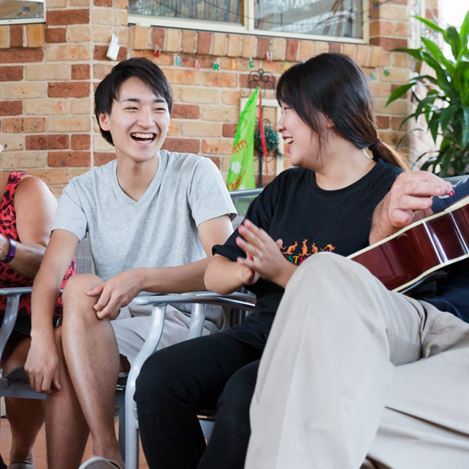
Your responsibilities as an under 18 student
Check UTS email account regularly.
Keep in contact with your Homestay Host or ISA guardian.
Abide by the accommodation policies and procedures concerning U18s
Always keep us updated with your contact details, especially your phone number. This is a condition of your student Visa.
Advise UTS College on departure and return dates if you wish to go on holidays.
Abide by the curfew rule of 10 pm – this includes weekends.
Do not travel in Australia without your parents or legal guardian.
Students must use UTS College approved transport to and from the airport.
Notes:
Explain how U18 students update their contact details – go to student centre and fill in “change of address/contact form”

Slide 4

International students
and work
All international students have the right to work.
But, you can’t work more than 40 hours per fortnight
Notes:
International students must not work more than 40 hours per fortnight. This is a condition of your student visa.
More information about Intl. students work rights covered in registrar session
The Office of the Fair Work Ombudsman is a government agency that provides free help and advice about working in Australia.
I encourage you to visit their website fairwork.gov.au to find out:
What you should be paid – they have a helpful pay calculator online
Your entitlements as an employee
If you’re entitled to holiday or sick leave
Fair Work has created a 'Record My Hours' for your smartphone that records your hours of work for you. It’s available for both Apple and Android phones.
If there's ever a problem with your pay or if other issues arise at work, I encourage you to speak with the Fair Work Ombudsman.

Slide 5
Student Accommodation

Slide 6

Accommodation
options
    Homestay with local families
    UTS College Student Residential Accommodation - Urbanest Darling Square and Darling House
    Special Host arrangements
    Department of Home Affairs approved arrangement
Notes:
After this I can ask students to tell me, how many in the room live in Urbanest and Homestay?

Slide 7


What is
Homestay?
    A safe and friendly environment.
    Located in Sydney suburbs with the average travel time to campus 45 – 60 minutes.
    Single room – bed, desk, lamp and chair along with internet access and meals.
    A great opportunity to practice English and learn about Australian culture.

Slide 8
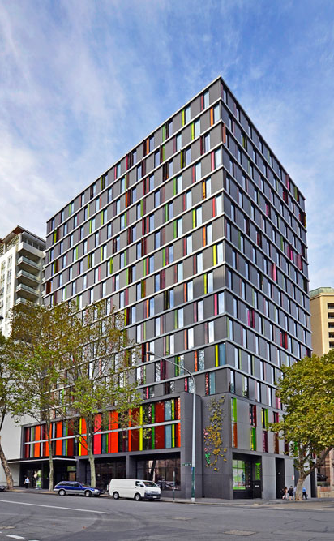
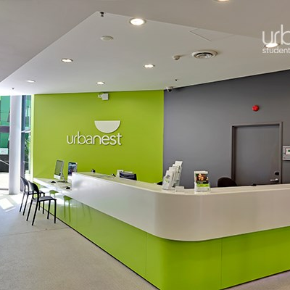
Urbanest
Urbanest is one of Australia’s largest providers of student accommodation.
Located just a short walk from the UTS College Blue Building.
Urbanest Darling Square (meals not included) and Darling House (meals included) give you the perfect combination of convenience and flexibility.
Ultra-modern facilities including study areas, collaboration zones and social spaces to connect with friends.

Slide 9
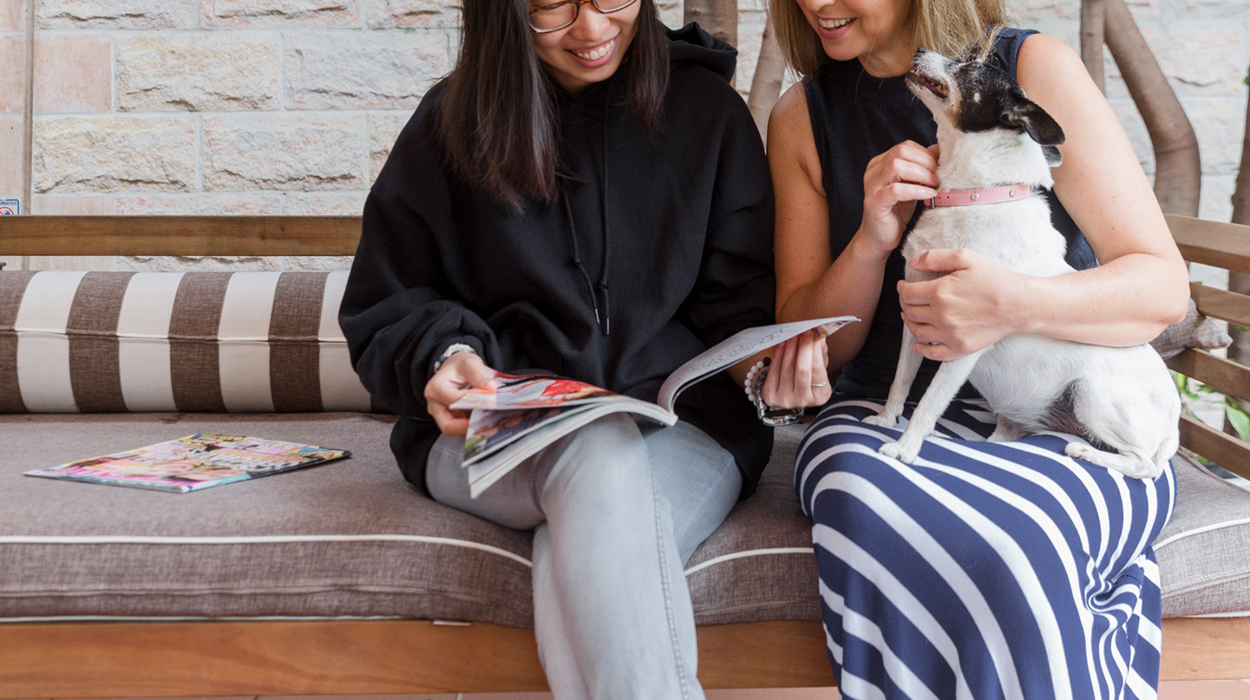





UTS College
Accommodation Partners
UTS College arranges your accommodation with the assistance of our four providers:
Homestay Australia
Urbanest
0410 318 466
Australia Homestay Network
1300 024 628
Homestay Australia
Stefan Morgan
0400 468 658
Global Experience
02 9264 4022
0430 008 448

Slide 10
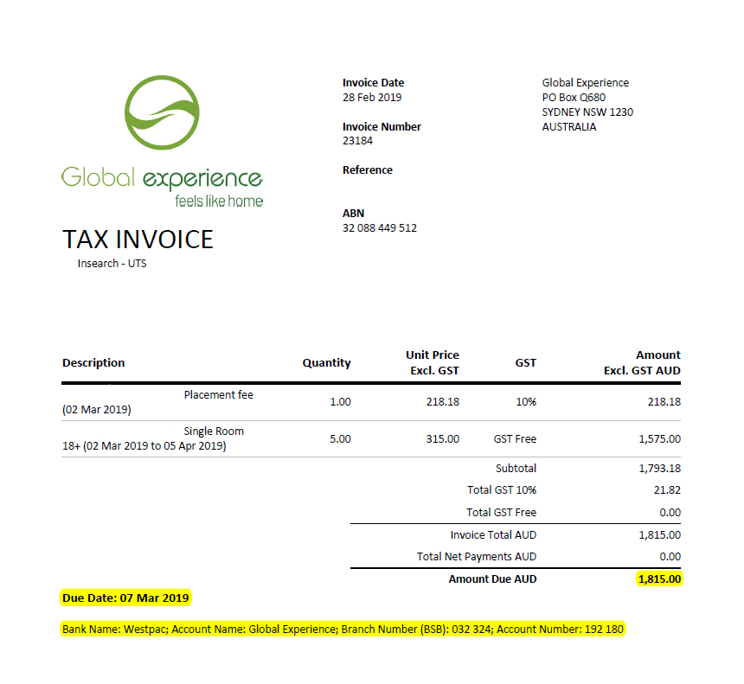
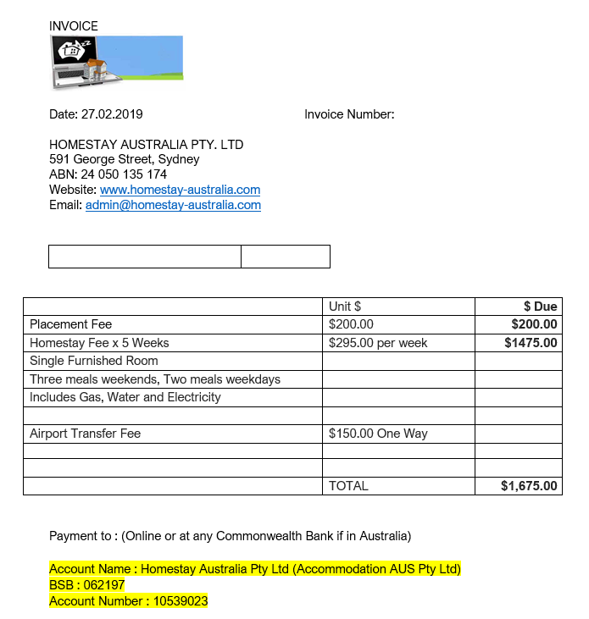
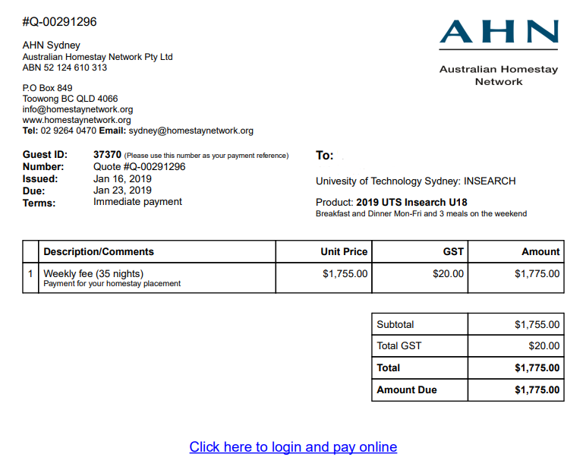
Homestay Bookings
Current Homestay booking for Under 18s
    Length of the booking – until your 18th birthday.
    You must inform your Homestay provider and accommodation team if you wish to extend your Homestay after your 18th birthday.
    Following payments made directly to the Homestay providers.

Slide 11
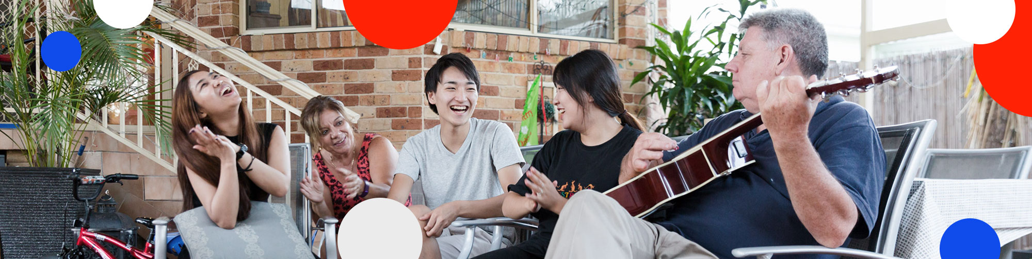
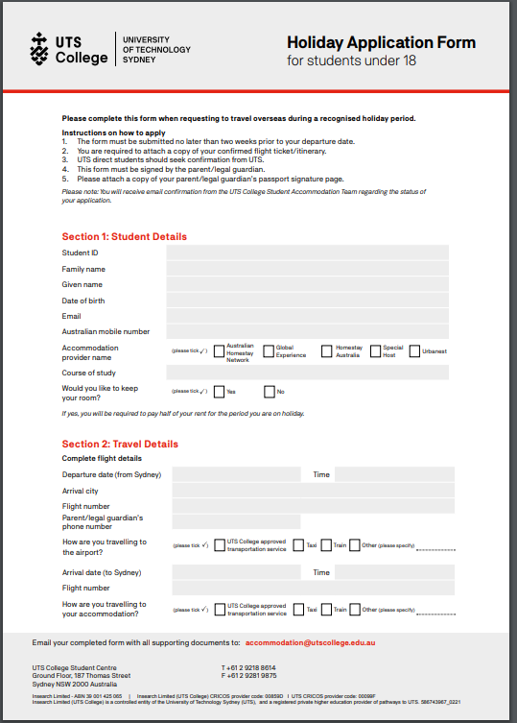
Planning to go on a holiday?
Under 18s must submit a holiday application 2 weeks before the holiday for approval.
You must use a UTS College approved transportation service to travel to and from the airport to the accommodation.

Slide 12

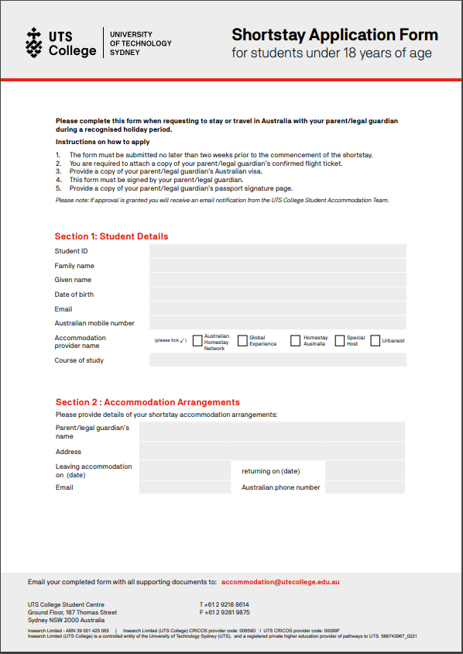
Planning for a short stay with your parent?
Under 18s must submit a short stay application 2 weeks before the short stay for approval.

Slide 13
Transport in Sydney
    Sydney has great transport links using train, bus, light rail and ferry.
    All Sydney public transport is now ticket free. To travel on Sydney public transport you must use an Opal card which you use to tap on and off transport. If you have a credit/debit card you can also use PayPass to tap on or off.
    By downloading the Opal card app or Tripview app you can search for a route, plan a trip, find out when the next transport is due and search maps.
    Sydney also has several taxi companies as well as ride share options such as Uber.

Slide 14
Student Welfare

Slide 15

What is
Student Welfare?
Student welfare comprises all the work that UTS College staff do to support and help develop the well-being of students.
Our aim is to create a safe and healthy university environment and to strengthen the mental health of our students. This includes encouraging and promoting diversity amongst our students.
As an under 18 year old this includes the approval and keeping us up to date with your accommodation and welfare arrangements.

Slide 16
Suggestions for students
When should I go to see a Study Success Adviser (SSA)?
Any problem that is affecting your ability to study
Study plan e.g. transfer to different course or progression to UTS
Sign up for peer mentoring program
Referral to other support services
Not sure about UTS College polices and procedure e.g. Intention to Report process for attendance or progress
Apply for special consideration or Access Inclusion program
Apply for a break or deferral/withdraw from your study
All discussions with advisers are private and confidential

Slide 17
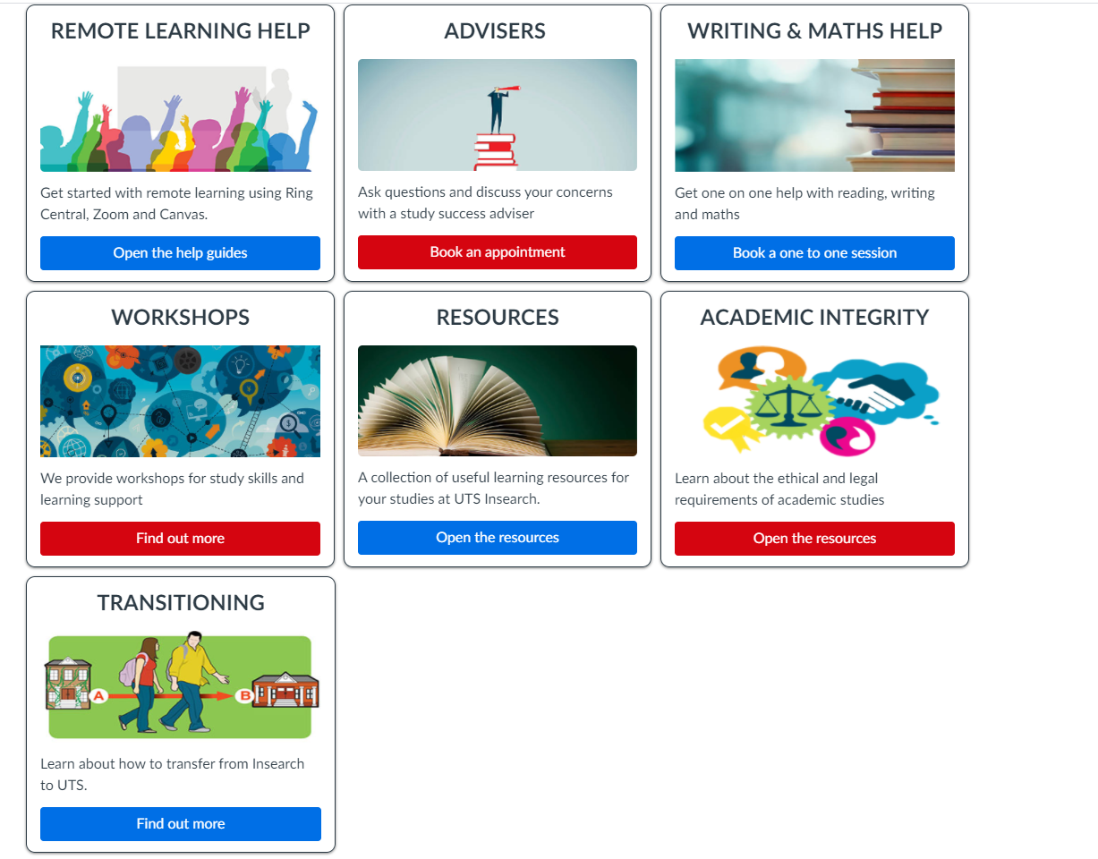
UTS College HELPS
Check the HELPS course on Canvas for tips and guidelines

Slide 18
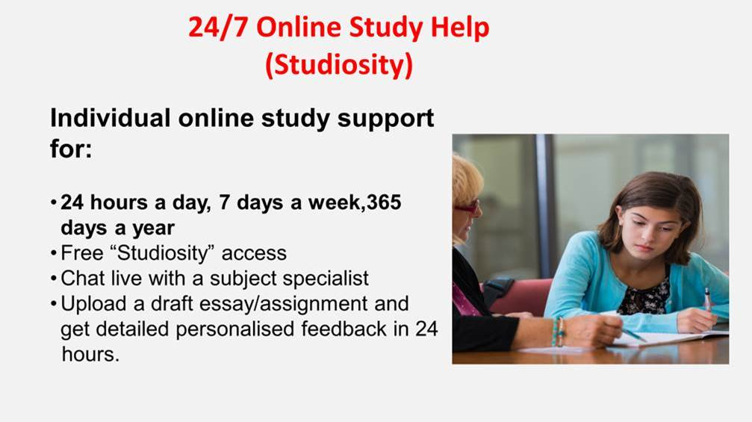

Slide 19


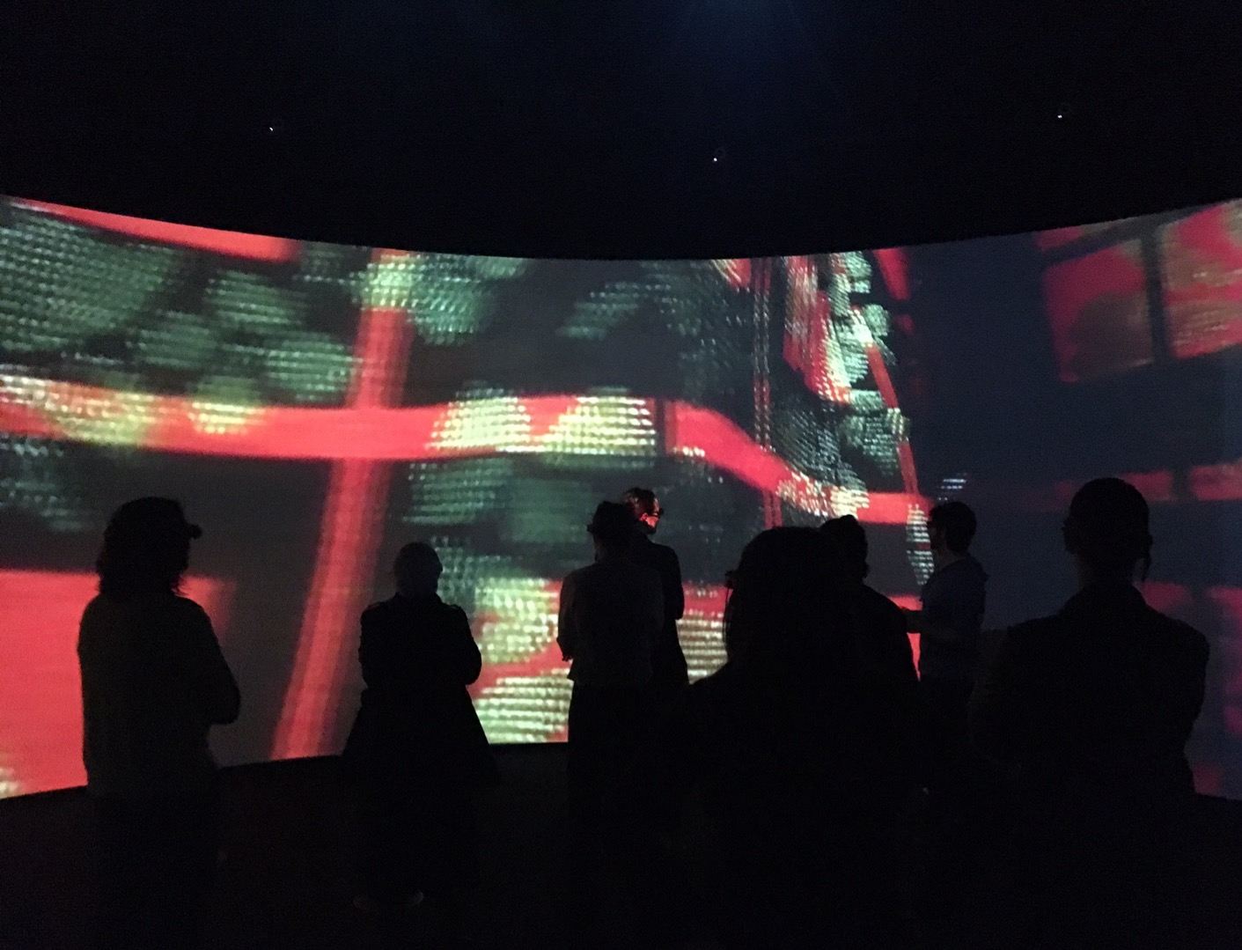
UTS College Student
Mentoring Program
Mentoring is an informal process, which gives new students the opportunity to meet other students who will help them to learn about student life and achieve academic success.
Buddy: A new student who would benefit from some guidance
Peer mentors provide support, encouragement and information to their buddies.

Slide 20

Benefits of having a Mentor
I don’t have any friends and I am feeling lonely and home sick any friends and I am feeling lonely
I don’t know how to study here
I am feeling depressed or anxious
I am addicted to video games
https://thestudentchannel.wordpress.com/tag/making-friends/

Slide 21
Meeting new people
at UTS College
Make friends through the following:
    Student Clubs and Activities – visit the student lounge and you will be able to join in with snow trips, basket ball games, movies and much more!
    Become a Student Volunteer – joining a team of UTS College students you can act as campus tour guide, help students during orientation and events.
    Sign up for the student mentoring program (SMP)–meet with senior students (mentors) to get help with studies and settling into your new life at UTS College
    Check out the Activities Calendar online.

Slide 22
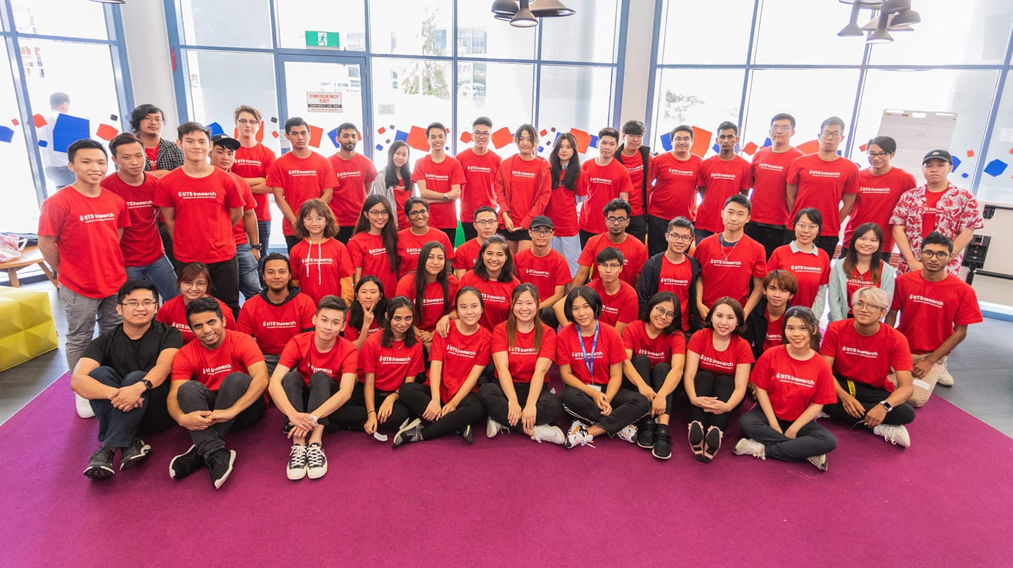
Student Helpers
Notes:
Introduce Student Activities

Slide 23

UTS
Health Services
Available at the main UTS campus, Monday-Friday
Medicare and Medibank bulk billing available
Notes:
The UTS Health Centre provides good health care and information so that students can get on with the job of being good students.
They can help with
treatment of a range of medical conditions, illnesses and other physical problems
consultations for a broad range of health, sexuality and lifestyle issues
women's health issues, including advice on contraception, pregnancy testing and antenatal care
travel advice and vaccinations.
information pamphlets on a broad range of health issues
vaccinations for nursing students (re clinical placement requirements)
advice or assistance for students with examination difficulties, or in need of special assessment arrangements because of a disability or medical condition.
The UTS Health Centre is located on level 6 of the Tower Building. Doctors are available to UTS Insearch students. See your Academic Handbook for more information.

Slide 24


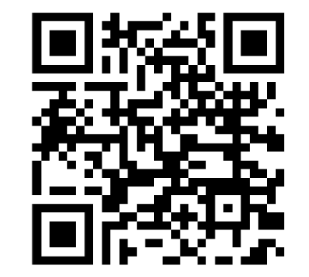
Overseas Student health insurance
for international students
Speak to the Medibank representative at the
Welcome Day next week or our friendly volunteers
Notes:
For our international students who have medical insurance with Medibank Private, there is a chance to speak with a representative from Medibank next week on Wednesday at the Welcome Day. There will also be representatives from Vodaphone if you want to arrange a mobile phone, Student Activities and some of the UTS clubs and societies

Slide 25


Slide 26

UTS
Counselling
services
Can help with:
Adjusting to studying and life in Australia
Loneliness or depression
Anxiety
See a Study Success Adviser first.
Notes:
UTS offers a confidential counselling service to help with a wide range of personal, psychological, study-related and administrative difficulties.
Counsellors can help in situations where you:
think you may have chosen the wrong course
have stressful circumstances or psychological or emotional issues which interfere with your studies
need help managing administrative problems or complaints
want to develop better generic learning skills
In most cases, the services are free. Otherwise they can be billed to Medicare or your health cover.
Academic Advisers can refer you to the UTS Counselling Service.

Slide 27

If you need
Legal advice or assistance
UTS Legal Service
or
Redfern Legal Centre
Notes:
If ever you need legal advice or assistance, we recommend you contact either the UTS Legal Service or Redfern Legal Centre.
Both these services provide free, confidential legal advice or referrals for:
Tenancy issues
Consumer claims
Contractual advice
Motor traffic matters
Criminal offences
and many other areas.
Please note that the UTS Student Legal Service cannot assist in claims involving or against UTS Insearch or migration matters.
See your Academic Orientation Guide for more information.

Slide 28

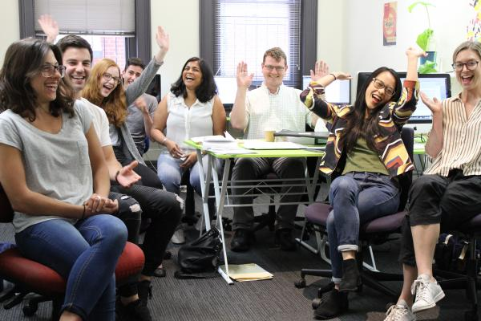
02 9698 7277
73 Pitt Street Redfern
rlc.org.au
Email: info@rlc.org.au
International Students
Tenancy & Housing
Employment
Money Problems & Consumer Complaints
Discrimination & Human Rights

Slide 29
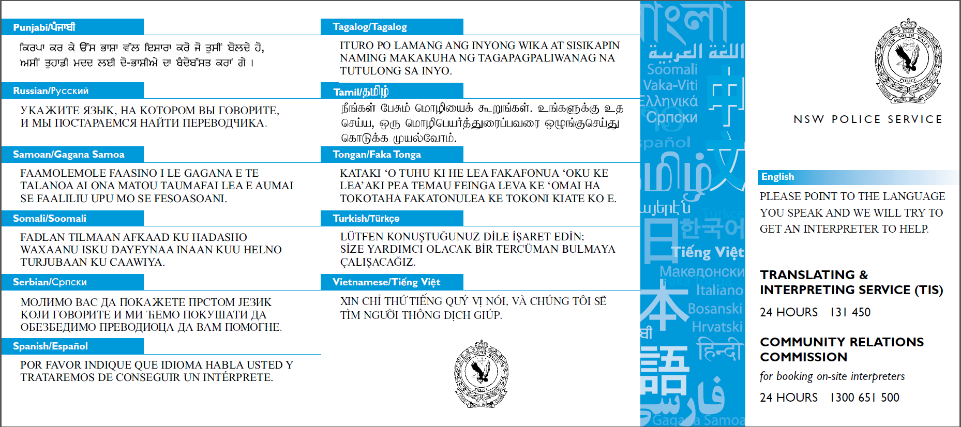

Slide 30
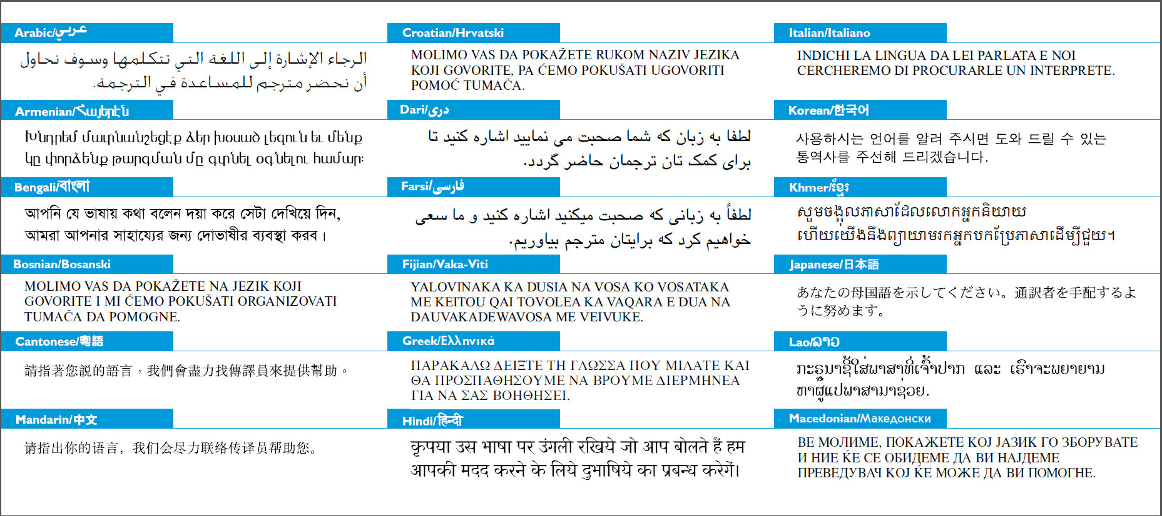

Slide 31
Cyber scams & telephone Fraud
If you’re ever contacted by mobile (text or call), email or social media and asked for money
DO NOT:
Respond
Click any links
Share any personal information
DO:
Contact the UTS Insearch
Student Welfare Team Leader,
Robert Brennan
  24-hour mobile: 0411 306 495
  Email: robert.brennan@insearch.edu.au
Alternatively speak to your teachers or your academic advisor about it
如果有人通过手机（短信或电话）、电子邮件或社交媒体联系您，并要求付款
请不要：
回复
点击任何链接
分享任何个人信息
请您：
联系UTS Insearch的学生福利团队领导Robert Brennan
  24小时可接通的手机号：
  0411 306 495
  电子邮箱：robert.brennan@insearch.edu.au
或者，向您的老师或学术顾问咨询此事
Nếu có bất kỳ ai liên lạc với bạn bằng điện thoại di động (gửi tin nhắn hoặc gọi điện thoại), email hoặc phương tiện truyền thông xã hội và hỏi xin tiền
ĐỪNG:
Trả lời
Bấm vào dòng liên kết (nếu có)
Chia sẻ thông tin cá nhân
HÃY:
Liên lạc với Trưởng Nhóm An sinh Sinh viên UTS Insearch,
Robert Brennan
  Điện thoại di động 24/24:
  0411 306 495
  Email: robert.brennan@insearch.edu.au
Hoặc nói chuyện với thầy cô hoặc cố vấn học tập của bạn về điều đó
Jika Anda pernah dihubungi lewat HP/ponsel (SMS atau telepon), email atau media sosial dan dimintai uang
JANGAN:
Menanggapi
Mengeklik tautan (link) apa pun
Memberikan informasi pribadi apa pun
LAKUKAN:
Hubungi Ketua Tim Student Welfare (Kesejahteraan Mahasiswa)
UTS Insearch, Robert Brennan
  24 jam HP: 0411 306 495
  Email: robert.brennan@insearch.edu.au
Atau, beritahulah guru atau penasihat akademis Anda tentang hal itu

Slide 32
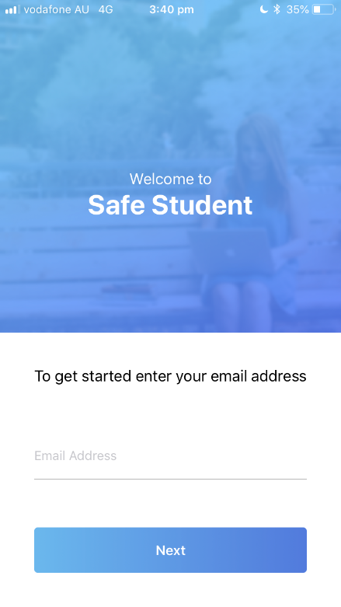
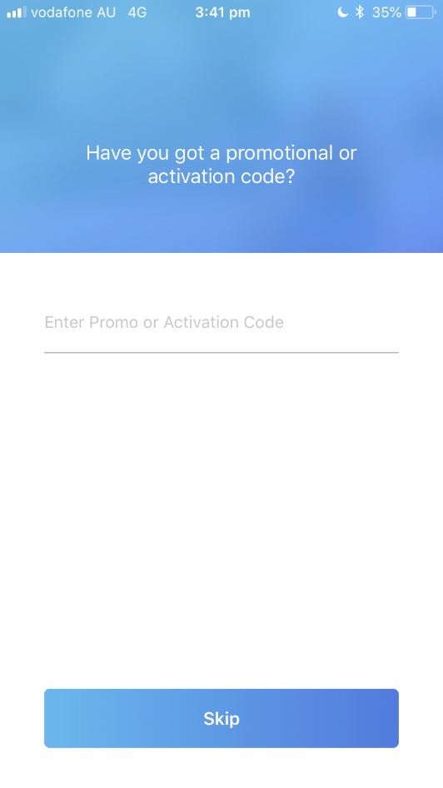
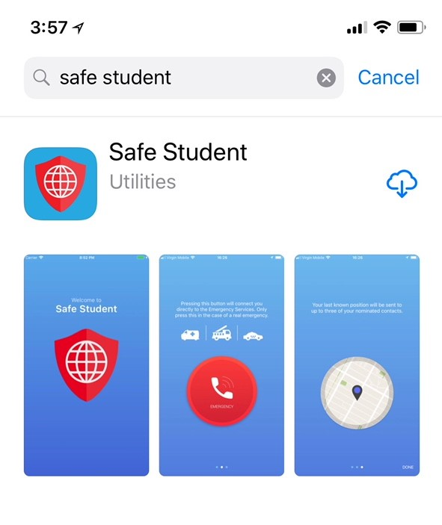
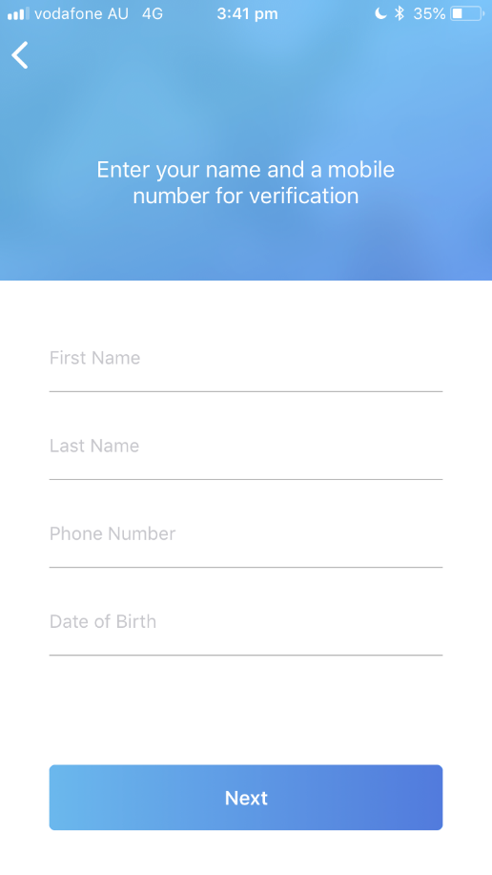
Free
StaySafe App
KIHSG2AW
Notes:
These are instructions on how to download Safety App – we get everyone to download, and then add emergency details as part of this activity

Slide 33
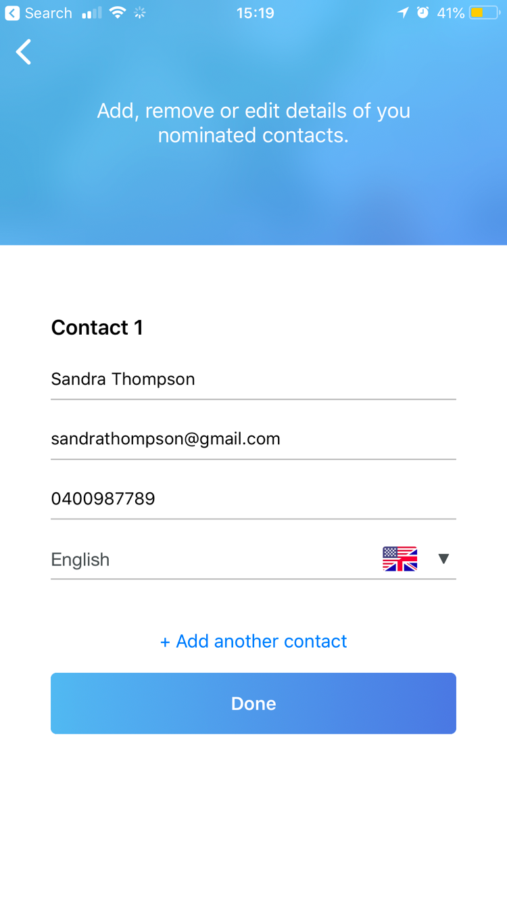

Free
StaySafe App
IMPORTANT – MOBILE PHONE NUMBERS NEED TO BE ENTERED IN FULL INTERNATIONAL FORMAT
+61, +86 Etc
Toggle the language to select the language you want the contact to receive the notification message in.
Aima Waheed
Aima.waheed@utscollege.edu.au
+61 419 224 861

Slide 34
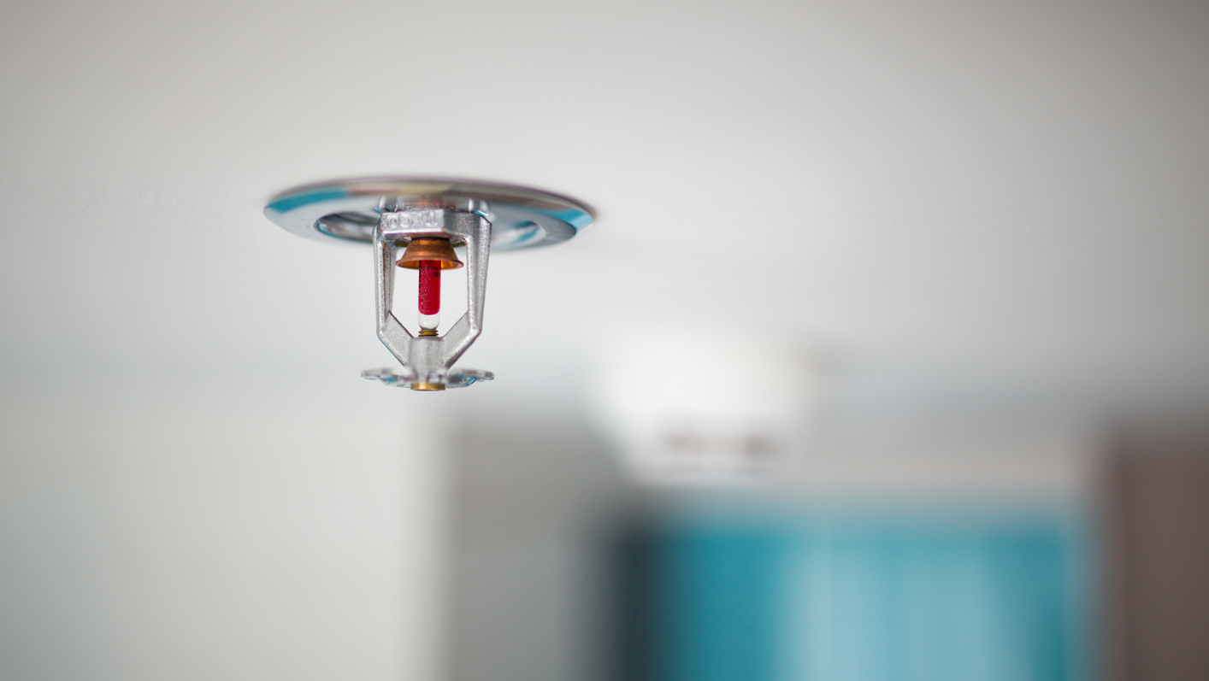
Call triple zero (000)
in emergencies
If you ever urgently need the police, fire & rescue or an ambulance dial
000
Keep the UTS College Safety Card in your purse or wallet – you never know when you’ll need it!
Notes:
The emergency number in Australia is ZERO-ZERO-ZERO for police, fire or ambulance emergencies.
For all our international students, I want you to get your phone and add this number to your contacts right now.
There is a UTS Insearch Safety Card in your Orientation bag
**Hold up the UTS Insearch Safety Card**
This card lists all UTS Insearch emergency contact details. Keep it in your purse or wallet.
NSW Police:
Call 000 in an emergency or use the Stay Safe App:
If you are a victim of theft
Violence
Sexual assault
Cyber crime
You are in immediate danger
NSW Ambulance
Call 000 in an emergency or use the Stay Safe App:
If you or a friend have been injured.
Sexual assault

Slide 35


Feedback
    Frequent checks - Welfare checks during your stay
    Arrival survey 2 weeks after arrival
    Departure survey after check out
    Survey results from our homestay providers
    Always ask you for feedback upon your visit at Student Centre
Notes:
We take complaints seriously and try to be fair.

Slide 36
Thank you!

