Slide 1
Thanks for joining our Remote Learning – Academic Programs Counsellor Training Webinar!
We’ll be starting in a few moments…
Notes:
Start at 2:58 – turn to next slide at 3:00pm (AEST)

Slide 2
Remote learning
Academic Programs
Notes:
[time allowance: 3 minutes]
EC:
Welcome back to those who are joining us again for our remote learning webinar.
To check that you can hear and see me well can you please type into the CHAT section YES
[wait for some responses]
Ok, that’s great.
Welcome everyone, thank you for supporting us and being online with us today.
We had a fantastic response to our first webinar on Student Support and Welfare and some very positive feedback which is encouraging for us because we are here to support you the best way we can in this challenging time.
Before we start, I’d like to introduce you to Mariam Kartikatrensi, our new Country Director for Indonesia. Mariam joined UTS Insearch in 2015 as Director of Indonesian Development where she facilitated the establishment of new ventures and partnership with government and higher education in Australia and Indonesia. She has been in the international education industry for 14 years.
30 secs: MK: hello and welcome everyone
And Pankaj Jain, Regional Director India and Subcontinent. Pankaj started at UTS Insearch early this year. He brings 21 years of experience in the International Education industry. He was the Director South Asia for the University of Leeds (UK) from 1999-2009 and also managed his own Consultancy firm for 10 years.
30 secs: PJ: hello and thanks for joining.
Today’s webinar will demonstrate how we are supporting our students to stay on track of their goal to study at UTS. We believe our remote learning provides our students with some unique opportunities to build resilience and adaptability, just some of our key learning outcomes that ensures their success at UTS and beyond. We are proud of our extensive academic, technical and welfare support services offered as we work to continuously improve our offerings based on student and teacher feedback.
Just a reminder we have the training material from today including the recorded webinar video available on our Channel Partner Portal and we’ll show you where to find these later in the presentation.
Feel free to contact myself or your Partner Manager if you have any questions.
Stay safe and stay positive.
I will now pass you over to Dhanya Bhatia, Partner Manager Subcontinent who will be hosting today’s webinar.
Over to you Dhanya…

Slide 3
What we’ll cover today
Remote Learning Academic Programs overview
Real-time classes
Remote learning delivery
A teacher’s perspective
A student’s perspective
Dates and important links
Q&A
Notes:
[TIME ALLOWANCE: 1 minute]
DB:
Thanks Eva
Today we are going to cover our remote learning academic programs. You’ll see some examples of what we are offering in our real-time classes and how we deliver that.
You’ll hear from one of our teachers on how they are delivering the content and from one of our students.
We will be sharing some important dates and links on where to find important information.
We also have a LIVE Q&A at the end so you can start thinking about questions you would like to ask on our remote learning offering.
Can I remind you all to please add your questions as the webinar is progressing in the Q&A section and NOT the CHAT section. I won’t be able to see them if they are in the CHAT section.
Thank you.

Slide 4
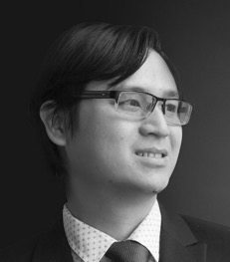
Meet our presenters
Vinh Tran Program Manager
Business
Linh Do Subject Co-Ordinator
Dr Janet Gibson Program Manager Communications LIVE Q&A
Eugustine Tan UTS Insearch student LIVE Q&A
Notes:
[time allowance: 1 minute]
DB:
I’m pleased to introduce our presenters for today’s webinar.
“With over ten years of experience in tertiary education, Vinh oversees the design and delivery of the Diploma of Business program both in Sydney and offshore centres, ensuring students graduating from the diploma are fully equipped with the knowledge, skills and ethical values to succeed in their further study and career. Vinh holds a Masters of Professional Accounting and Master of Commerce from Macquarie University after completing his Bachelor of Commerce from RMIT Vietnam.”
Linh Do is the Subject Coordinator for Accounting Transactions and Business Decisions in the Business Program for UTS Insearch, where his key roles are to coordinate the curriculum and delivery of teaching the accounting subject so that Insearch students learning experience is of the highest quality, preparing them for successful further higher education. Linh holds a Bachelor of Business at University of Technology Sydney (UTS) and Master of Financial Planning at University of New South Wales (UNSW Sydney).
Dr Janet Gibson is our Program Manager Communications. She is joining us today for the LIVE Q&A so please have some questions for her on our Academic Program Remote Learning offering and she will be happy to answer.
Janet has been in the role for 13 years and oversees curriculum quality, working closely with the School of Communication at UTS to ensure that the UTS Insearch Diploma is relevant, up to date and strongly connected to the first year of the UTS Bachelor of Communication.
Eugustine Tan started at UTS Insearch in October 2018 and his studying a Dip. Engineering. He is back home in Malaysia now and in his final semester before he articulates to UTS in July 2020. We will be talking to Eugustine today about his experience with our Remote Learning.

Slide 5
Notes:
[time allowance: 22 minutes]
FD to play video
https://www.youtube.com/watch?v=1TS-8kVxB-c&feature=youtu.be

Slide 6
A student’s experience
Eugustine Tan Diploma of Engineering student at UTS Insearch
Notes:
[Time allowance: 3 minutes]
DB:
We would now like to invite Eugustine Tan to join us so we can find out more about his experience with our remote learning.
Eugustine, can you tell us what you are studying and a little bit about when you returned to Malaysia and commenced remote learning to stay on track to get to UTS.
What are the timings of the classes? Are they in local time? If not, how do you manage this?
How do you cope if the internet connectivity is not good during real time class? Do you have access to recorded sessions?
What is one advantage/disadvantage of studying through remote learning?
What is your experience with an online test? Is there anything different or challenging compared to in-class tests? Do you have any advice for students’ preparation?
Internet connection is a real challenge for students when studying online, they can also get frustrated when they can’t catch up with their remote learning class work. Do you have any advice to overcome this?
Thank you Eugustine, very insightful to hear from a student perspective.
Eugustine will be staying with us for the LIVE Q&A so please start preparing any questions you have for Eugustine and his experience with remote learning.

Slide 7
Q&A with Janet Gibson, Eugustine Tan and Partner Managers
Notes:
[time allowance: 10 minutes]
DB:
Now is the time to ask your questions, can I remind you all NOT to use the CHAT section, please use the Q&A section.
Dhanya: I would like to kick the Q&A off with a questions we’ve received from a few of you since our move to remote learning and that is about pricing.
Remote learning is a very effective mode of education. Our programs delivered using remote learning lead to the same qualifications, which take students into their UTS degree, and in many cases, they can fast-track to the second year at UTS depending on the course chosen.
Critical to UTS Insearch’s commitment to educating students are delivery of: high quality curriculum (aligned with UTS), small class sizes, personal attention and support - and our remote learning offers this too. We are continuing to invest in the student experience and deliver this with our high standards. We have made significant investments to help ensure the educational experience is not interrupted or put on hold for many months, so students can actualise the benefits of their education as soon as possible and stay on track to get to UTS.
We provide a wide range of student support through our Study Success Advisers to keep students on track. In additional to teacher-led classes, there are workshops to enhance Academic and English skills and online social activities being developed to keep students connected. Our classes use the latest technology and modern learning management systems, supported by a friendly IT team.
For these reasons, discounting tuition fees is not appropriate.
If any student is facing financial hardship because of COVID-19 impacts, they should contact our Welfare Team to discuss their specific situation.
[Annette to send Dhanya the questions through private chat. DB to read the questions out loud and field to the appropriate person for answering.
Janet, Eugustine or the PMs]
[Once time is up DB to end the session with:]
DB:
Thanks for the questions, keep them coming and we will continue to answer them offline. We will have the Q&A, on-demand webinar and presentation available for you on our partner portal which we will show in shortly where to find that information and a host of other valuable information to help you counsel students.
A big thank you to Janet, Eugustine and all the Partner Managers for joining us today.

Slide 8
Who to contact
Your Partner Manager for any queries
insearch.edu.au/information-for-partners
Notes:
[time allowed: 30 secs]
DB:
A reminder for you all to please contact your Partner Manager for your any remote learning questions

Slide 9
2020 important dates Academic programs
Semester 2 |  | Semester 3
Commences | 22 June | Commences | 6 October
Orientation | 22-26 June | Orientation | 6-9 October
Census date | 24 July | Census date | 6 November
Notes:
[time allowed: 30 secs]
DB:
A friendly reminder of the important dates for the rest of 2020.
The commencement date, Orientation week and Census date for Semester 2 and 3 you need to be aware of.

Slide 10
Your feedback counts
Please take our quick poll survey so we can continue to improve our webinar experience!
Notes:
[time allowed: 2 minutes]
DB:
We would like to hear your feedback on today’s webinar so we can continue to improve them for you.
We just have three quick questions that will take less than a minute. You will see the poll pop up on the screen now so if you could please take part we would appreciate it.
[Host to launch polls – once poll disappears DB to continue]

Slide 11
Keep updated!
For all our latest updates go to:
insearch.edu.au/au/coronavirus
Insearch.edu.au/remote-learning
Notes:
[TIME ALLOWANCE: 30 SECS]
DB:
Importantly here are some links to keep you updated on what we have been doing in relation to the coronavirus and our remote learning.
These pages are regularly updated so I encourage you to familiarise yourself with these pages as they will provide you with the latest information for your students.

Slide 12
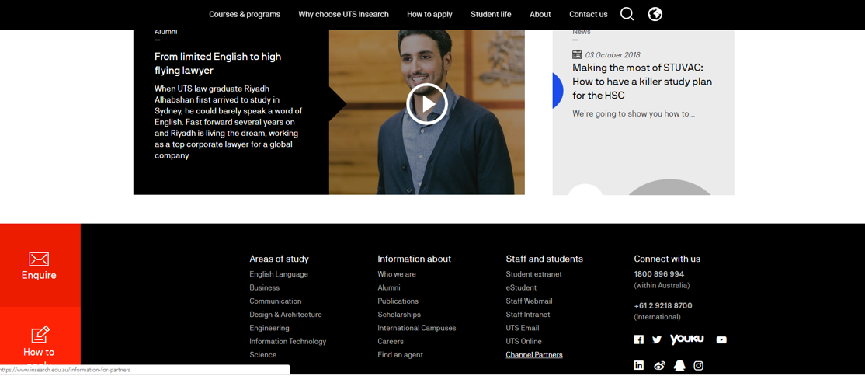
Where to find training material
Notes:
[TIME ALLOWANCE: 30 SECS]
DB:
We’ve had some questions from our partners where they can find our training material.
On our main page, go to the bottom of the page, click on CHANNEL PARTNERS

Slide 13
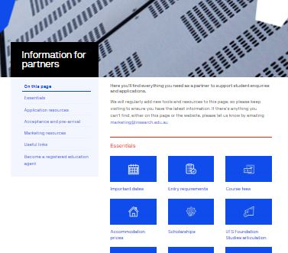
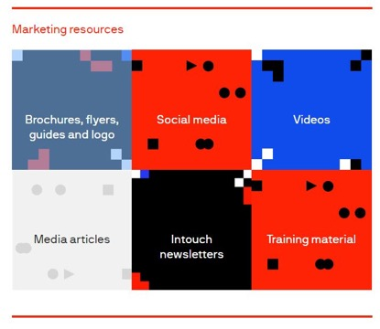
Where to find training material
insearch.edu.au/au/information-for-partners/marketing-resources/training-material
Notes:
[TIME ALLOWANCE: 30 SECS]
DB:
Click on MARKETING RESOURCES
And click on TRAINING MATERIAL.
If you haven’t had a look at what is available for you on the Partner Portal I invite you to go in and explore what material and assets we have for you and your team.

Slide 14
Keep your questions coming!
Our Q&A will close in five minutes
Notes:
[time allowed: 5 minutes]
DB:
I want to thank you for joining us today and we trust you found it useful so you can confidently promote UTS Insearch to your students.
Thank you to Dr Janet Gibson, Eugustine Tan, Eva Choi and all our Partner Managers and the team behind the scenes of this webinar.
Keep your questions coming and we will continue to answer them offline.
From all of us at UTS Insearch, we want to wish you all the best, stay positive and stay safe.
[DB to leave this slide sharing, mute and turn off camera – do not exit the webinar. The host will end the webinar for all after 5mins]

